Slide 1
HTTP SSE VS SignalR Websocket SSE

Slide 2
Why it’s matters?
Real-time communication in modern web applications
Common approaches: SSE (Server-Sent Events) and WebSocket.
HTTP Single long-lived HTTP connection
SignalR as a framework simplifying real-time communication in .NET.

Slide 3
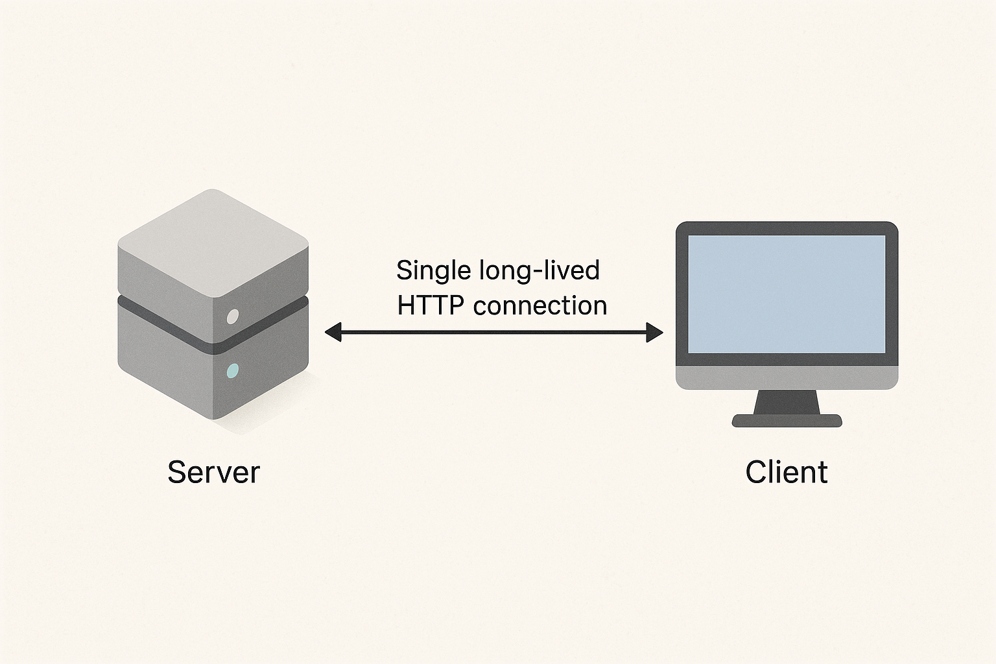
HTTP SSE
A unidirectional communication protocol
Uses a single long-lived HTTP connection
Client subscribes to events.
JobLogId

Slide 4
Simple implementation using standard HTTP.
Native browser support (EventSource API).
Works well for lightweight, one-way notifications.

Slide 5
SignalR with WebSocket
SignalR abstracts real-time communication, using WebSocket when available.
Full-duplex communication over a single TCP connection.

Slide 6
Benefits
Supports bidirectional messaging.
Automatic fallback to other transports (Long Polling, SSE) if WebSocket is unavailable.

Slide 7
SSE vs SignalR/WebSocket
SSE: Lightweight for one-way updates.
WebSocket: Efficient for frequent, two-way communication.

Slide 8

Security
Both support HTTPS; SignalR integrates with ASP.NET authentication.

Slide 9




Implementation
Waiting for the job …
9cd59e …
9cd59e … -> HttpContext
7c16f2 … -> HttpContext
66bbf7 … -> Httpcontext
694a52 … -> HttpContext
9cd59e …
9cd59e …
9cd59e …
9cd59e …

